Slide 1
Functional connectivity methods
Iain Stitt

Slide 2
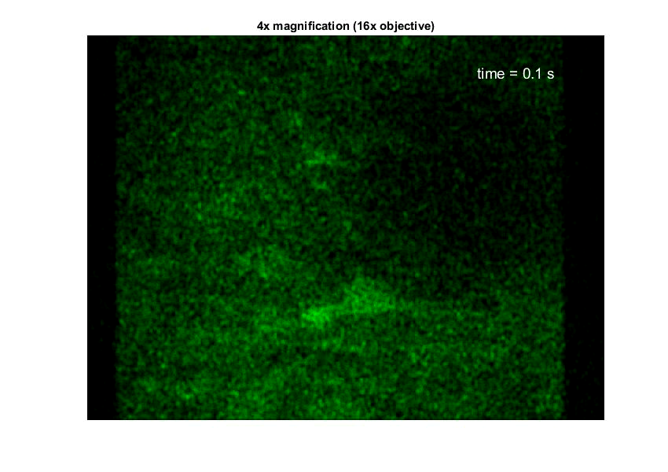
But first……… our first two-photon imaging!
* Stuber lab mouse

Slide 3
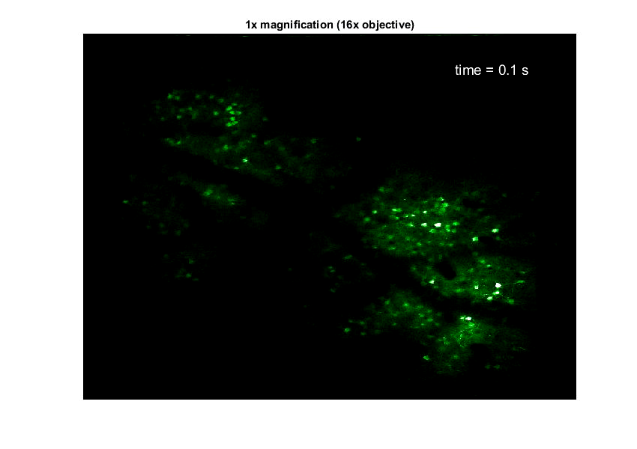
* Stuber lab mouse

Slide 4
Functional connectivity methods
Iain Stitt

Slide 5
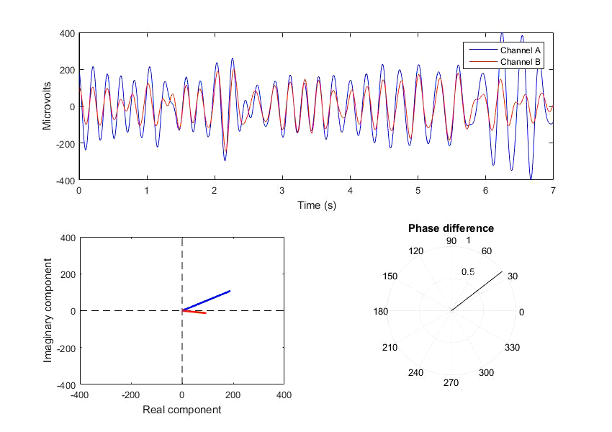
A simple case…
Variables:
- Phase
- Amplitude
What to do?
Notes:
We record two brain signals (EEG or LFP)
Filter them in a desired frequency band – when looking by eye they appear to be synchronous.
What to do?
Get the analytic representation of the signal by computing the Hilbert transform (or wavelet)
The analytic signal has both real and complex (imaginary) components, and we can use it to extract instantaneous phase and amplitude

Slide 6
Methods that quantify different kinds of functional connectivity:
Phase locking value (Just phase)
Coherence (Phase and amplitude)
Phase slope index (based on coherence)
Amplitude envelope correlation (Just amplitude)

Slide 7
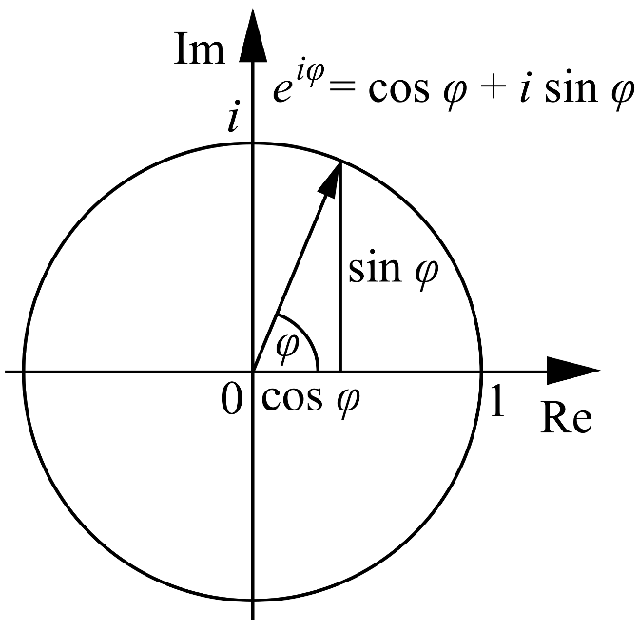
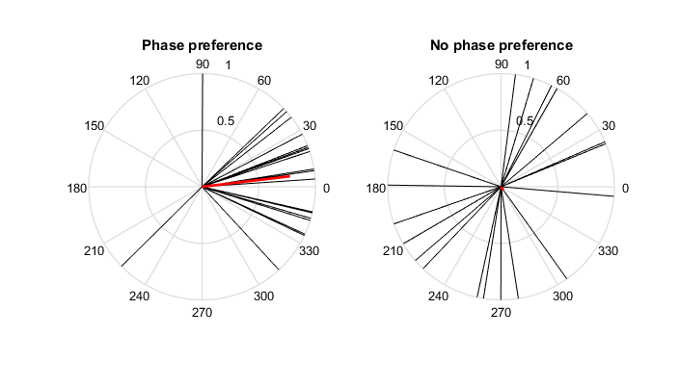
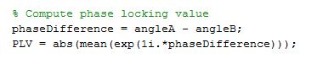
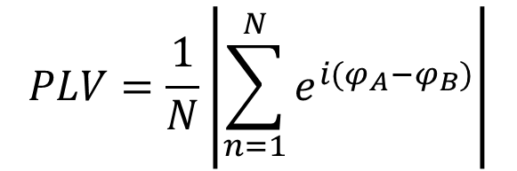
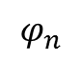
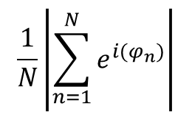
Phase locking value (PLV)
Mathematically
Intuitively
Project the phase (or difference in phase) of each observation onto a unit circle
$$PLV=\frac{1}{N}\left|\sum_{n=1}^{N}{e^{i(φ_{A}−φ_{B})}}\right|$$
$$\frac{1}{N}\left|\sum_{n=1}^{N}{e^{i(φ_{n})}}\right|$$
$$φ_{n}$$
Matlab
PLV is then defined as the length of the mean of all unit vectors

Slide 8
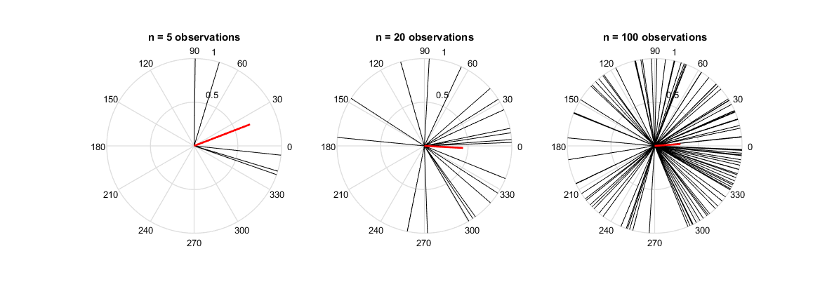
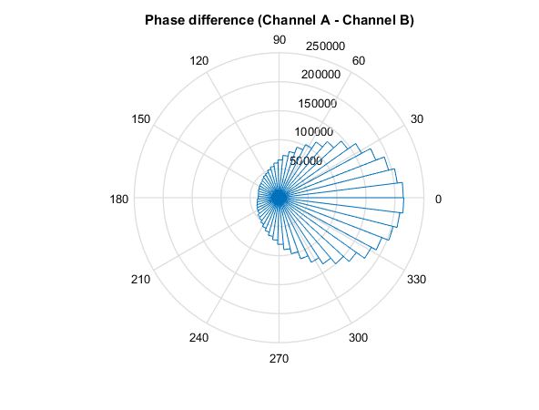
PLV is dependent on the number of observations used
Underlying distribution

Slide 9
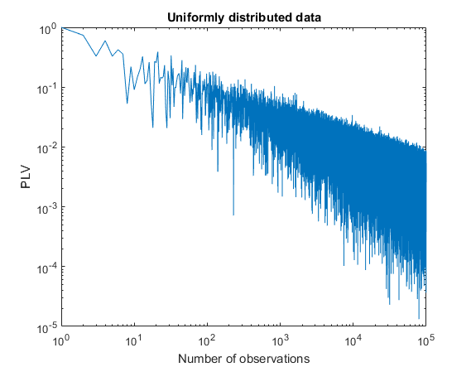
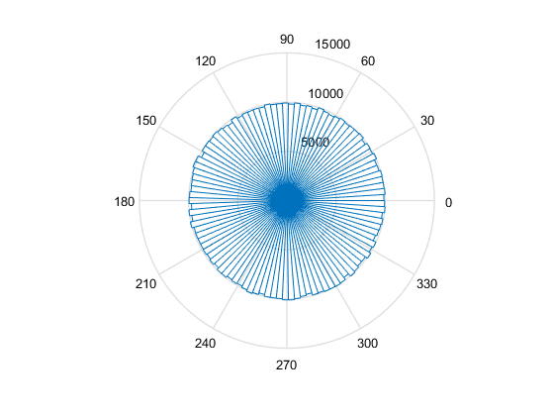
PLV is biased towards 1 with few observations, and 0 with many observations
When comparing groups and conditions you must use the same number of observations to compute PLV (otherwise results are meaningless)

Slide 10
Back to our example…

Slide 11
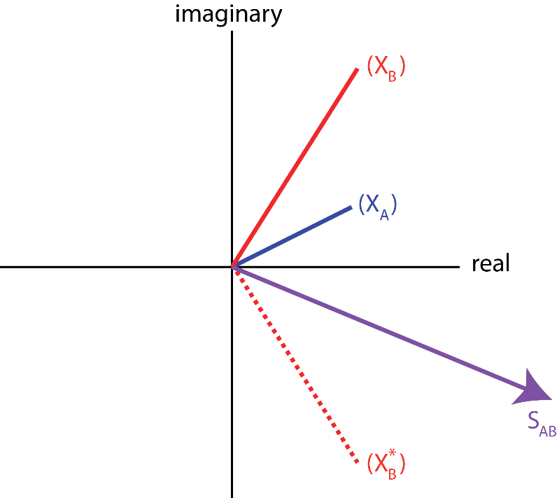
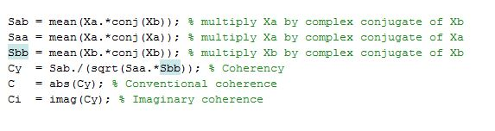
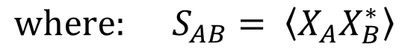
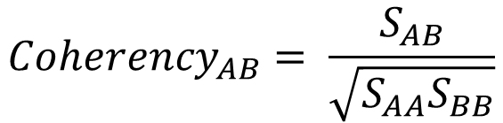
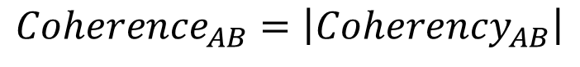
Coherence
Intuitively
Mathematically
$${Coherency}_{AB}= \frac{S_{AB}}{\sqrt{S_{AA}S_{BB}}}$$
$${where: S}_{AB}= \left\langle X_{A}X_{B}^{∗}\right\rangle$$
$${Coherence}_{AB}=\left|{Coherency}_{AB}\right|$$
Matlab

Slide 12
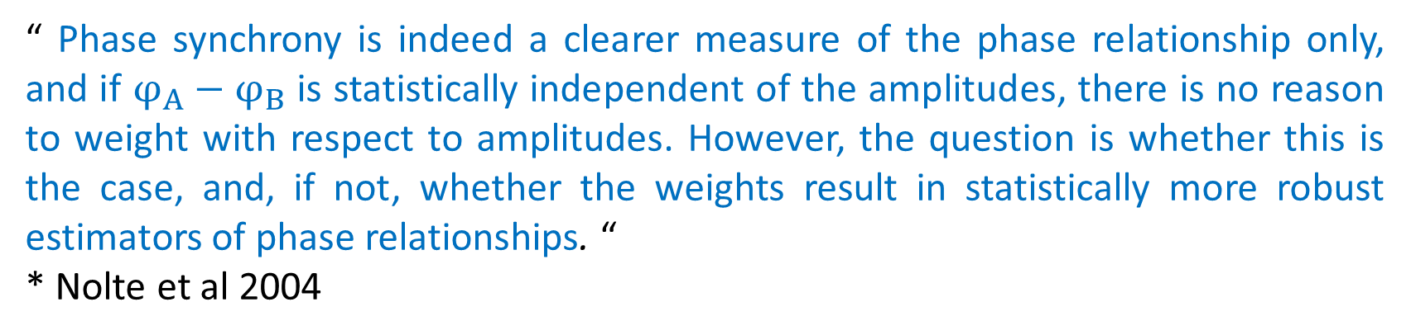
Coherence
If amplitudes == 1, then coherence reduces to phase locking value
However, some have argued that weighting phase differences with amplitude leads to more robust measures of interaction:
“ Phase synchrony is indeed a clearer measure of the phase relationship only, and if $φ_{A}−φ_{B}$ is statistically independent of the amplitudes, there is no reason to weight with respect to amplitudes. However, the question is whether this is the case, and, if not, whether the weights result in statistically more robust estimators of phase relationships. “
* Nolte et al 2004

Slide 13
Coherence
“ Also, one could argue, in the case of coherence, that assigning a stronger weight to observations with a large amplitude product, one is favoring those observations that have a higher quality phase difference estimate. This realistically assumes that a higher amplitude reflects a higher SNR of the sources of interest and thus, a better quality phase estimate. “
* Bastos & Schoffelen 2016

Slide 14
My view: Coherence vs PLV
In the case of clean, artifact-free recordings coherence should be favored.
However, with electrophysiology it is very often the case that we have artifacts (both physiological and non-physiological) common to all recording sites.
Weighting by amplitudes disproportionately amplifies the contribution of high amplitude outliers to the estimate of interaction.
Therefore, unless controlling for zero-phase interaction (next slides…) I feel it is safer to use PLV.
Your thoughts?

Slide 15
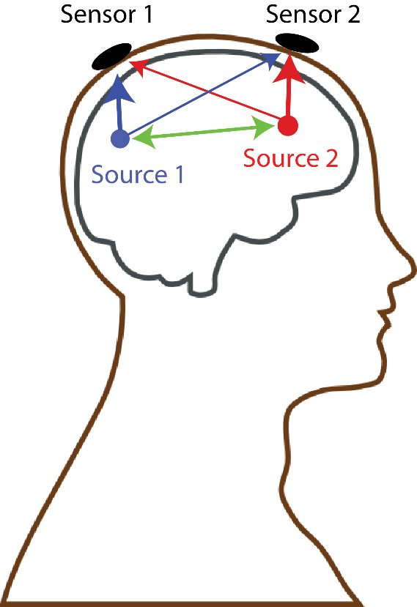
The volume conduction problem:

Slide 16
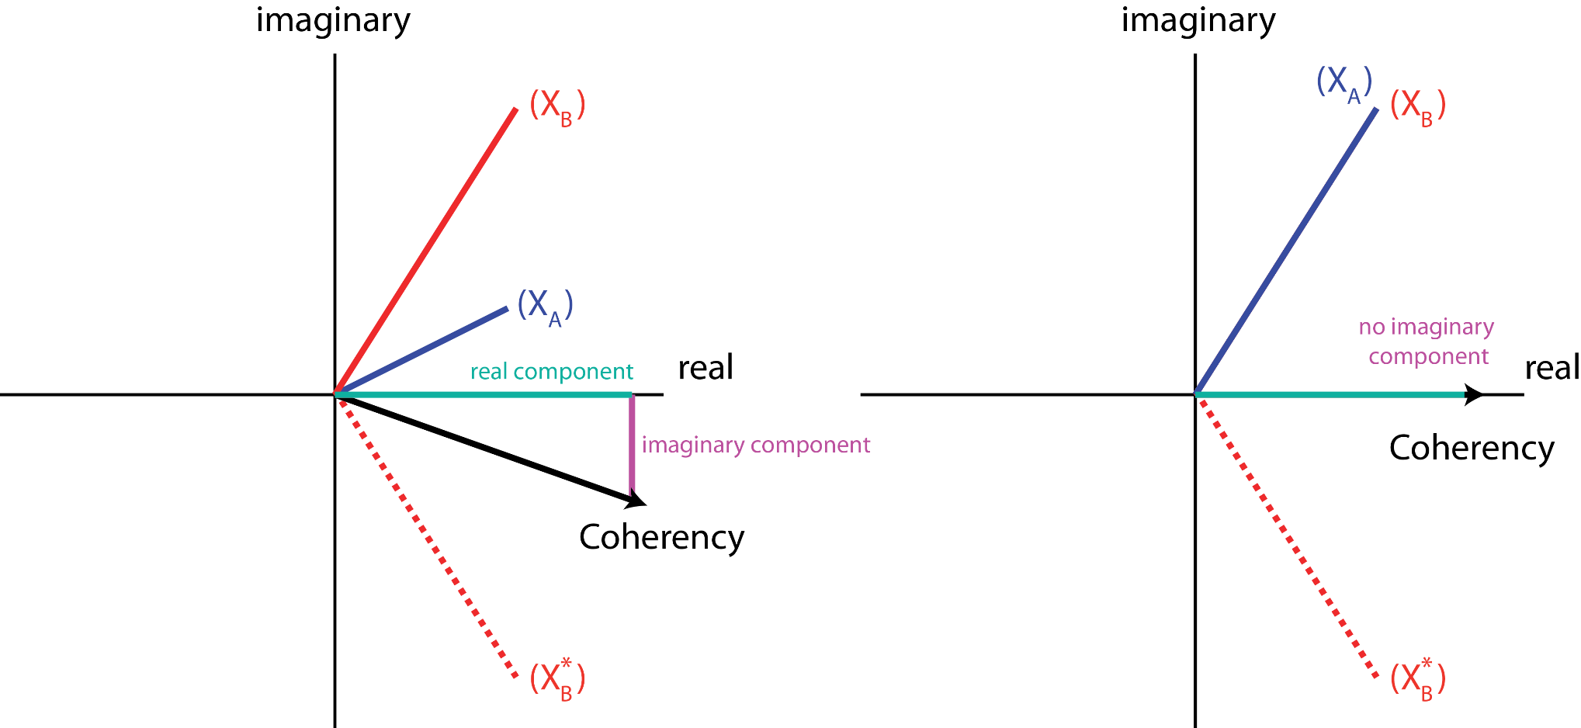
We solve this by breaking Coherency down into its real and imaginary components
True interaction
Volume conduction
Real part = zero-phase lagged component
Imaginary part = non zero-phase lagged component

Slide 17
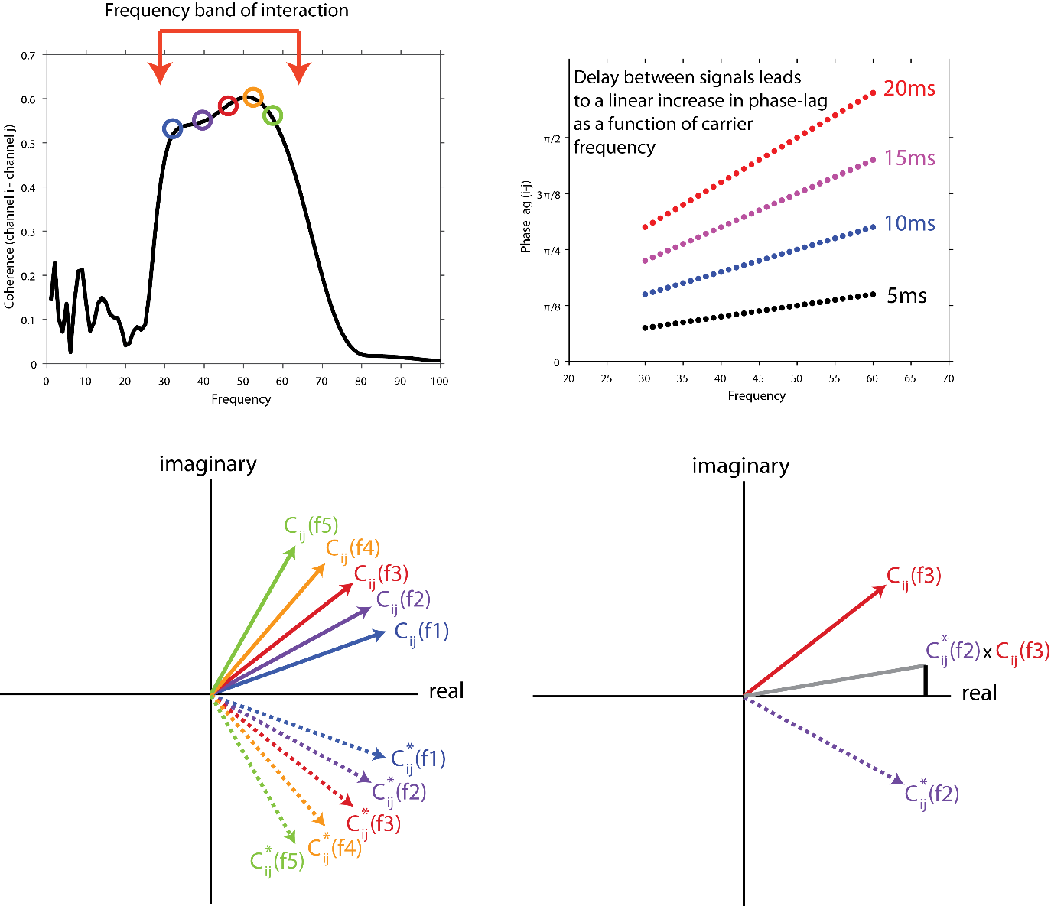
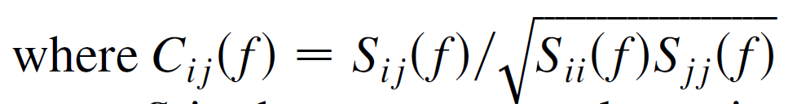
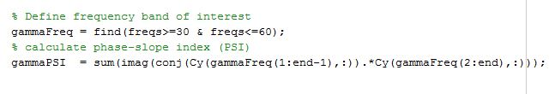
Phase Slope Index (directed interaction)
Intuitively
Mathematically
Matlab

Slide 18
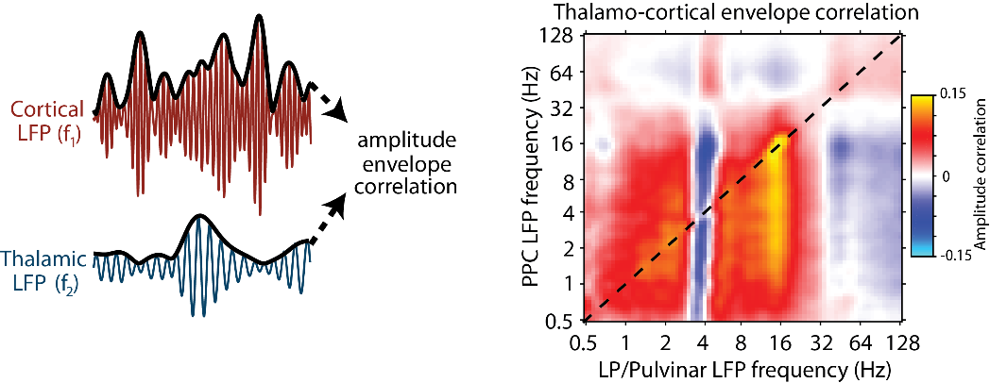
Amplitude envelope correlation
The analytic amplitude must be used (not power!)

Slide 19
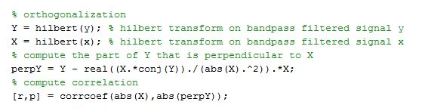
Amplitude envelope correlation following orthogonalization
Like coherence, amplitude envelope correlation is very susceptible to volume conduction (especially in EEG)
To control for this, we can compute the part of signal Y that is orthogonal to signal X
Mathematically
Intuitively
Matlab

